Slide 1

Project Title -Healthcare Analytics for Doctor Visits
-TIRTC
Presented By:
Velampalli Venkata Sai Sujeevan
Aicte Id-STU658046cf7f3e11702905551

Slide 2

PROBLEM STATEMENT
Healthcare organizations generate large amounts of patient-related data. However, it can be difficult to understand the factors that influence how frequently patients visit doctors.
This project focuses on analyzing healthcare data to identify patterns and relationships between doctor visits and patient characteristics, such as:
Age
Gender
Income
Illness
Health condition
Chronic conditions
Reduced activity
Healthcare coverage
The project uses data analytics and visualization techniques to convert raw healthcare data into meaningful insights.

Slide 3
Project Description
Healthcare Analytics for Doctor Visits is a data analytics project that analyzes patient healthcare information to understand patterns in doctor visits.
Using Pandas and NumPy, the data is cleaned and analyzed. Different factors such as age, gender, income, illness, health status, and chronic conditions are compared with the number of doctor visits.
Matplotlib and Seaborn are used to create visualizations such as:
Bar charts
Histograms
Box plots
Scatter plots
Pie charts
Correlation heatmaps
These visualizations make it easier to identify trends and relationships in healthcare utilization.

Slide 4

WHO ARE THE END USERS?
Who Are the End Users?
The project can be useful for different healthcare-related users:
🏥 Healthcare Organizations
To understand patient visit patterns and healthcare demand.
👨‍⚕️ Doctors & Medical Professionals
To understand patient characteristics associated with frequent visits.
📊 Healthcare Data Analysts
To analyze healthcare utilization and discover meaningful patterns.
🏛️ Healthcare Administrators
To support healthcare resource and service planning.
🔬 Researchers & Students
To study healthcare data and develop further analytical models.

Slide 5

Technology Used
Programming Language
Python
Used for data processing, analysis, and visualization.
Development Environment
Jupyter Notebook
Used to write and execute Python code interactively and document the analysis.
Libraries
Pandas
Used for data loading, cleaning, manipulation, and analysis.
NumPy
Used for numerical calculations and statistical operations.
Matplotlib
Used to create graphs and charts.
Seaborn
Used to create attractive statistical visualizations and relationship plots.

Slide 6
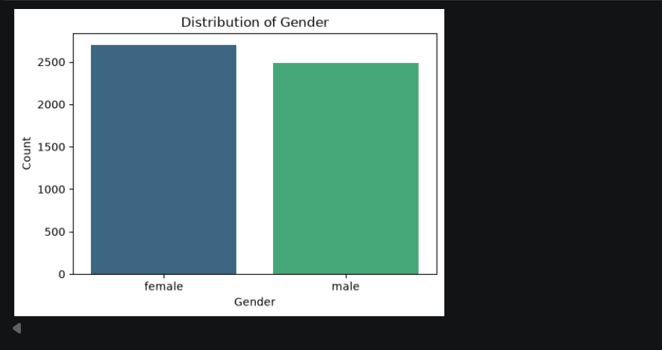
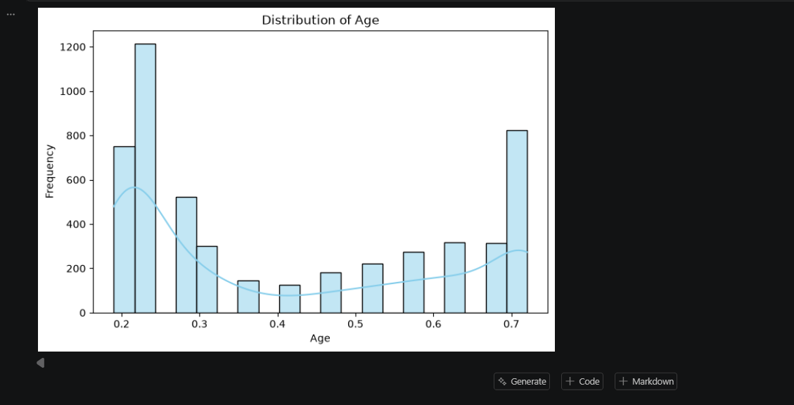
RESULTS – GENDER & AGE DISTRIBUTION
These demographic patterns provide a basic understanding of the patient population included in the healthcare dataset.
GitHub Link

Slide 7
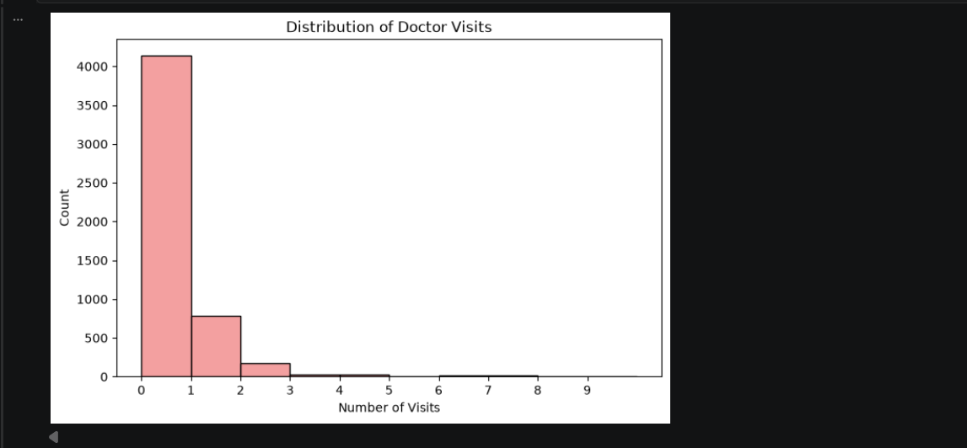
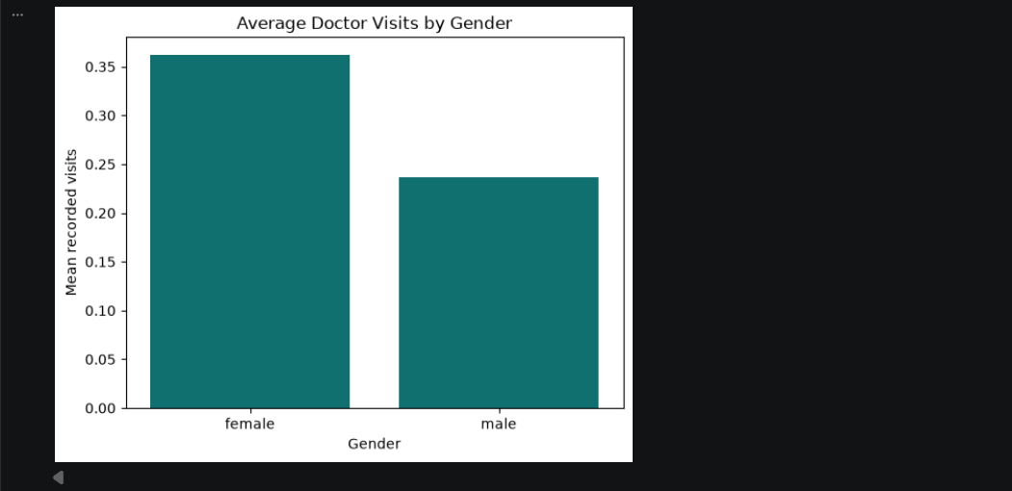
RESULTS – DOCTOR VISITS & GENDER ANALYSIS
[Add screen shots of your code ]
The doctor visits distribution shows how frequently patients visited doctors and highlights the common visit patterns in the dataset.
The gender analysis compares the average number of doctor visits between male and female patients.
These results help understand healthcare utilization patterns across the patient population

Slide 8
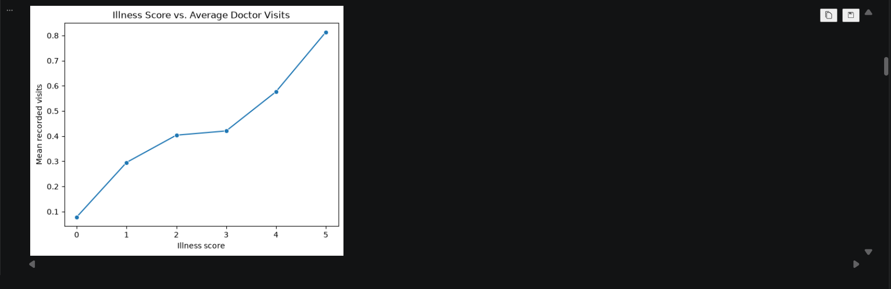
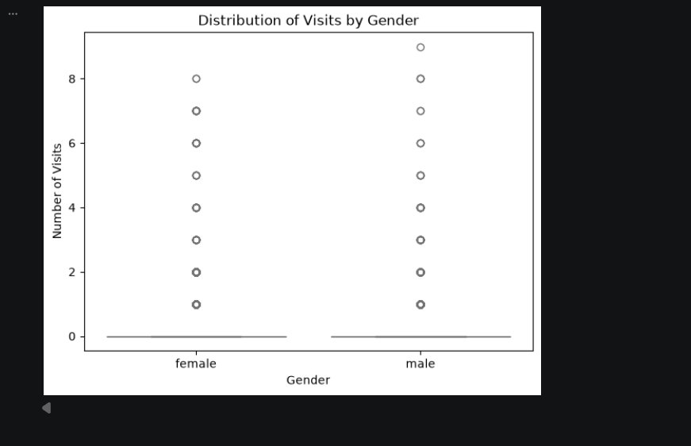
RESULTS – ILLNESS & GENDER ANALYSIS
The illness analysis shows how the average number of doctor visits changes with different illness levels in the dataset.
The box plot compares the distribution and variation of doctor visits between male and female patients.
These analyses help identify differences in healthcare utilization based on illness level and gender.

Slide 9
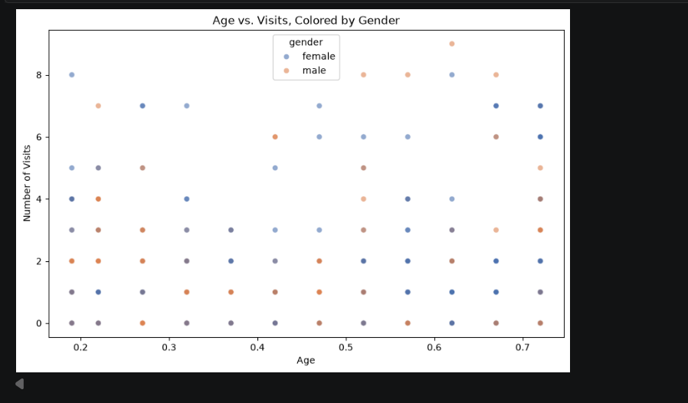
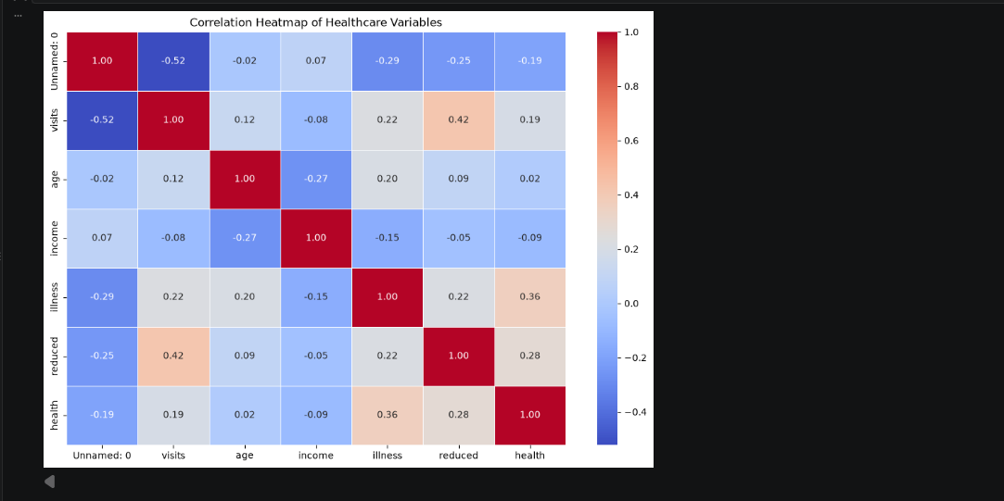
RESULTS – AGE & CORRELATION ANALYSIS
[Add screen shots of your code ]
The scatter plot shows the relationship between patient age and the number of doctor visits, with gender used to distinguish the observations.
The correlation heatmap shows the strength and direction of relationships among the numerical healthcare variables.
These visualizations help identify patterns and relationships that may be useful for understanding doctor visit behavior.

Slide 10
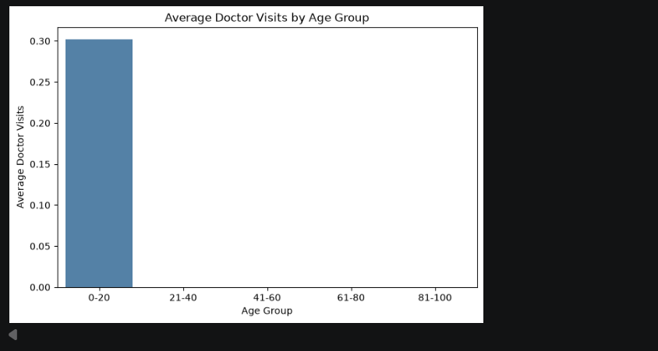
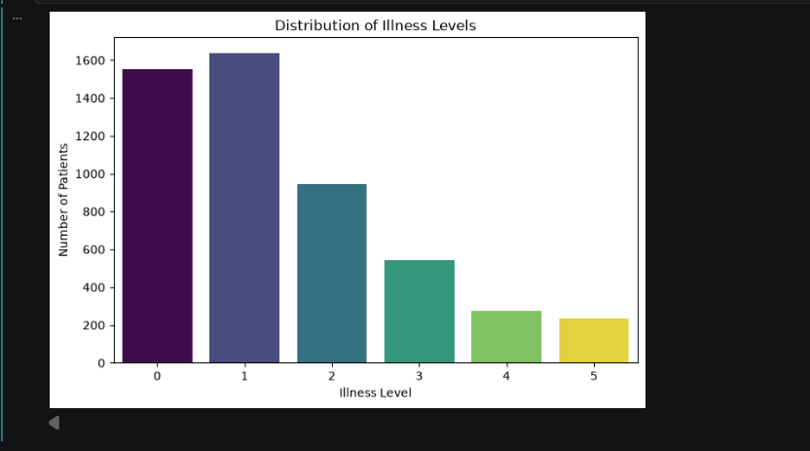
RESULTS – AGE GROUP & ILLNESS ANALYSIS
[Add screen shots of your code ]
The age-group analysis compares the average number of doctor visits across different patient age groups.
The illness distribution shows how patients are distributed across different levels of illness in the dataset.
These results help understand how age and illness patterns are associated with healthcare utilization.

Slide 11
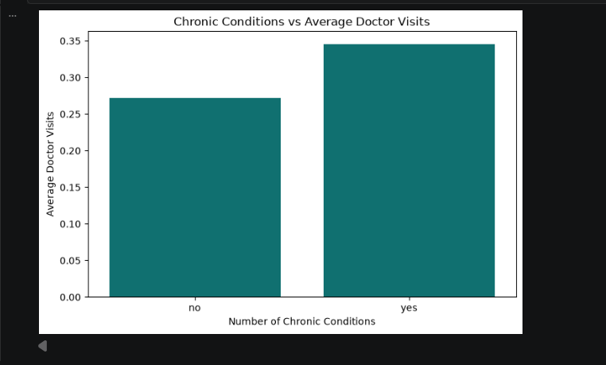
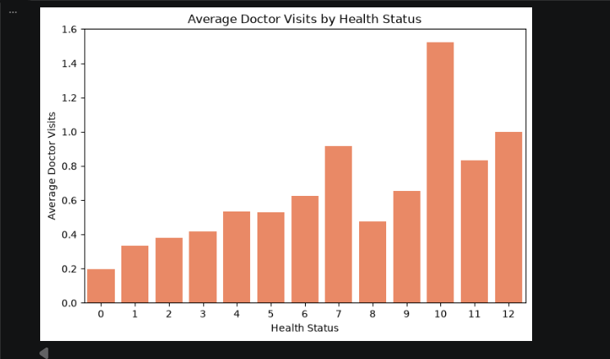
RESULTS – DOCTOR VISITS & GENDER ANALYSIS
[Add screen shots of your code ]
The chronic-condition analysis compares average doctor visits based on the number of chronic conditions reported by patients.
The health-status analysis shows how average doctor visits vary across different health-status categories.
These results help understand the relationship between patients’ health conditions and their use of healthcare services.

Slide 12
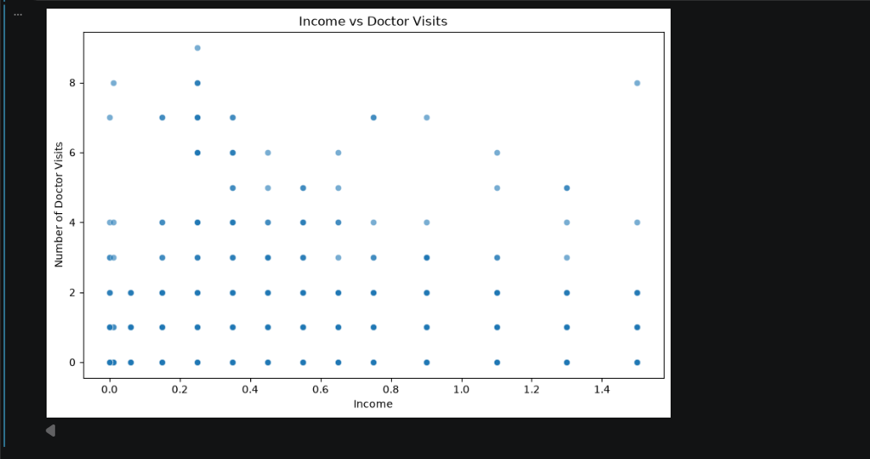
RESULTS – INCOME & DOCTOR VISITS
[Add screen shots of your code ]
The scatter plot shows the relationship between patient income and the number of doctor visits.
It helps identify whether doctor visit patterns vary across different income levels.
This analysis provides a socioeconomic perspective on healthcare utilization in the dataset.

Slide 13
Conclusion
The Healthcare Analytics for Doctor Visits project demonstrates how Python-based data analytics can be used to analyze healthcare data and understand doctor visit patterns.
The project uses Pandas and NumPy for data processing and analysis, while Matplotlib and Seaborn are used to visualize important relationships and trends.
The analysis considers different patient-related factors such as age, gender, income, illness, health status, and chronic conditions.
Overall, the project shows how healthcare data can be transformed from raw records into meaningful information that can help healthcare professionals, analysts, researchers, and administrators better understand healthcare utilization.
.
.

Slide 14
Thank you
.
.

